Slide 1
Weekly Review

Slide 2
Duolingo
Logan Cruz – 150 days
Alex Plitt – 125 days
Riley Rorrer, Friend Quest, except he stopped doing Duo weeks ago and I had to do the whole quest myself.

Slide 3
Duolingo
Why does Mr. Smith tell you to do Duolingo?

Slide 4
Bonus Submissions
Mac Hoover
Wrote a detailed description of whatever he did. Didn’t tell me where it lives on Github because he didn’t read the DocPac
Parker Fink
Made SmithPool, a pog-betting site where seniors can bet on whether they will get yelled at in the Weekly Review or not.
Also not on Github, because nobody reads these DocPacs. Seriously, why do I even go through all the stress of writing these DocPacs each week? I mean, if I had taken all of the time it took me to write these, then subtract the amount of time you spend reading them, and used that amount of time on other things, like curing cancer, there would be no more cancer.

Slide 5
Reflections
I dunno. I didn’t read them. I mean you don’t read anything I put in the DocPac, so why should I read anything YOU put in the DocPac?

Slide 6
My Reflection
I forgor
I actually had some really good stuff for the time-management section, but I didn’t write down a note so I completely forget.

Slide 7
This week / Loose Ends
Read the DocPac
If there is an error in the DocPac, message me, then FIX it and open a PR.
I haven’t graded two weeks of DocPacs. Oops!

Slide 8
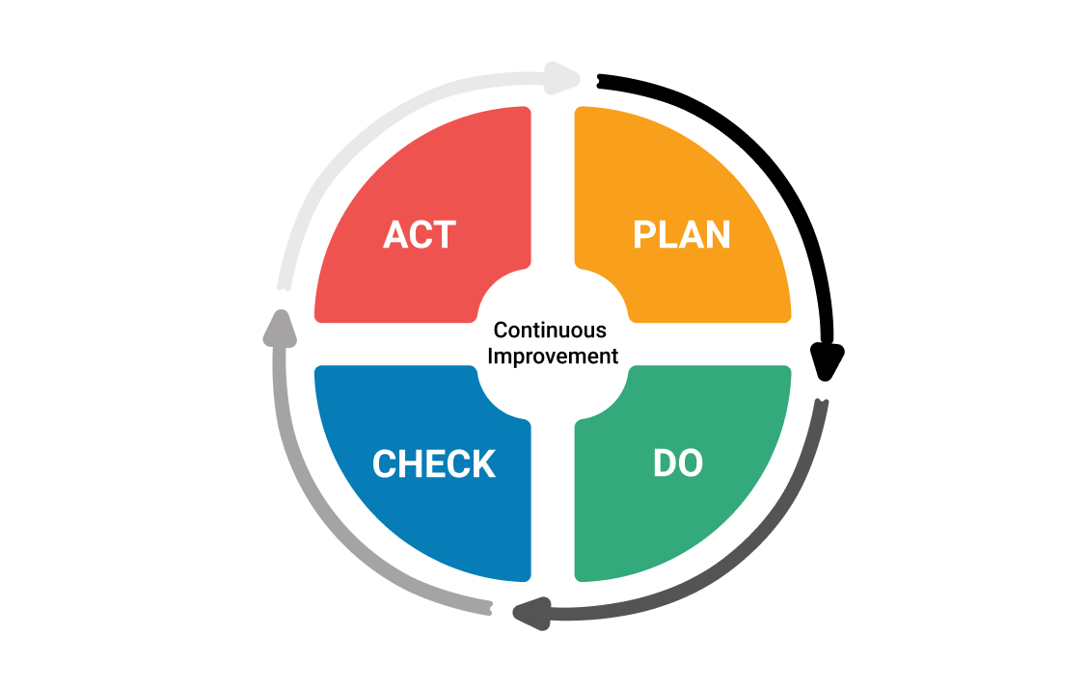
Continuous Improvement

